Slide 1

COFFEE SHOP SALES ANALYSIS

Slide 2
START YOUR DAY WITH COFFEE
The main objective of this project is to analyze retail sales data to gain actionable insights that will enhance the performance of the Coffee Shop.

Slide 3
QUESTIONS :
Q: How do sales vary by day of the week and hour of the day?
Q: Are there any peak times for sales activity?
Q: What is the total sales revenue for each month?
Q: How do sales vary across different store locations?
Q: what is percentage size distribution base on orders?
Q: Which products are the best selling in terms of quantity?
Q: How do sales vary by product category and type and tell Top Selling Categories?

Slide 4
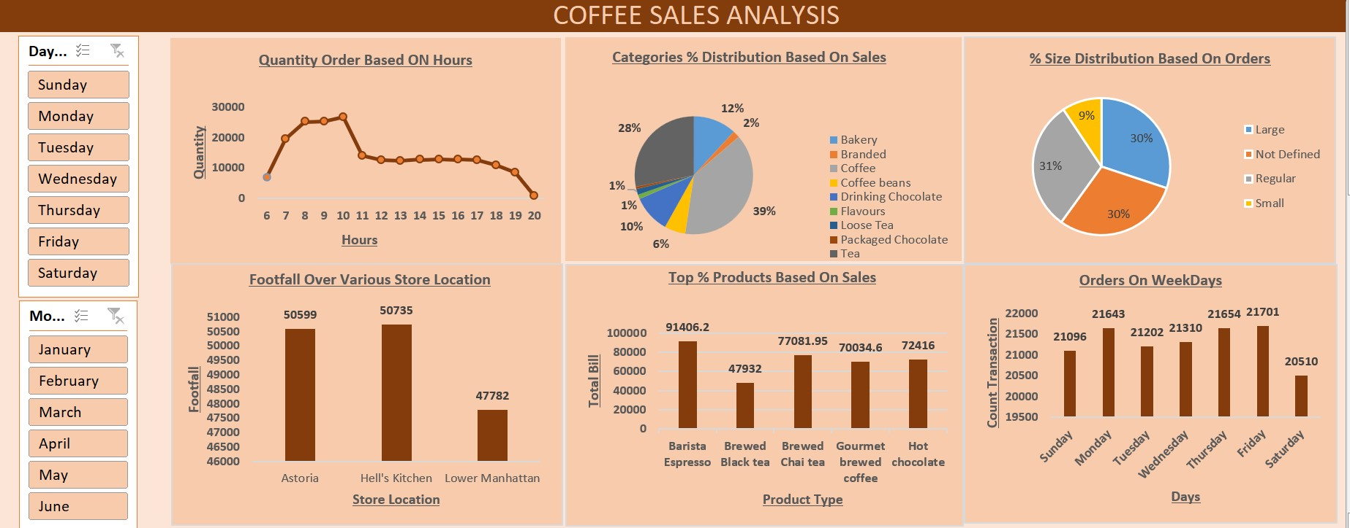
RECOMMENDED ANALYSIS

Slide 5
Q: How do sales vary by day of the week and hour of the day?
Weekdays vs Weekends: Sales are higher on weekdays than on weekends. Mondays have the highest total sales, followed by Tuesdays. Weekends see a significant drop in sales compared to weekdays. Sunday has the lowest total sales of the week.
Hours: Sales are highest in the morning between 7 am and 10 am.
There is a lunchtime slump, and then sales pick up again in the afternoon, although not to the same level as the morning rush.

Slide 6
Q: Are there any peak times for sales activity?
Yes, there are peak times for sales activity according to the data in the image. The chart labeled "Quantity Order Based On Hours" shows that sales peak in the morning between 7 am and 10 am. There is a lunchtime slump, and then sales pick up again in the afternoon, although not to the same level as the morning rush, but weekends seem to have a flatter sales curve throughout the day.

Slide 7
Q: What is the total sales revenue for each month?
The total coffee sales are shown in the chart titled "Footfall Over Various Store Locations." Here, we can see the monthly sales figures for three locations: Astoria, Hell's Kitchen, and Lower Manhattan. The chart also shows the combined total coffee sales for these three cities. For reference, the monthly sales figures are: January = $17,314, February = $16,359, March = $21,229, April = $25,335, and May = $33,527.

Slide 8
Q: How do sales vary across different store locations?
Total Sales by Location In The Month Of May :
Astoria appears to have the highest total sales in May at $11,475.
Hell's Kitchen seems to have the second lowest total sales in May at $11,294
Lower Manhattan seems to have the Lowest total sales in May at $10,758.

Slide 9
Q: what is percentage size distribution base on orders?
Based on the pie chart labeled "% Size Distribution Based On Orders" in the image, here is the percentage size distribution based on orders:
Small: 9%
Medium: 30%
Large: 30%
Regular: 31%

Slide 10
Q: Which products are the best selling in terms of quantity?
Based on the charts and graphs , here are the best-selling products in terms of quantity:
Quantity :
COFFEE 38%
TEA 28%
Since the donut chart labeled " Categories % Distribution Based On Sales" groups Coffee and Tea together, it is impossible to say for certain which sells more in terms of quantity. However, these two categories together account for the largest percentage of sales (66%).

Slide 11
Q: How do sales vary by product category and type and tell Top Selling Categories?
Coffee (38%) and Coffee beans (6%) and combined both (44%)
Tea 28%
Bakery 12%
Drinking Chocolate 10%
Packaged Chocolate, Loose Tea, Flavours, Branded ( less than or equal to 2%)
Top Selling Categories:
Coffee (38%) and Coffee beans (6%) and combined both (44%)
Tea 28%

